Slide 1
Evaluating Student Writing
Kaggle Project
Statistical Inference and Data Mining
Tom Kessous
Ari Schwartz

Slide 2
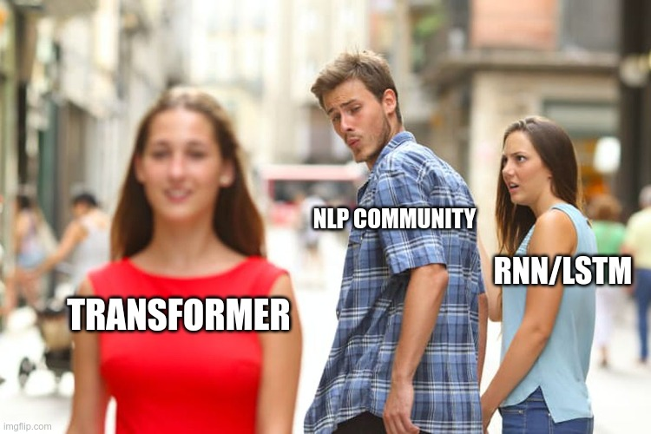
Natural Language Processing
Our task deals with natural language text classification.
NLP is a quickly evolving field.
Since about 2010, all state of the art NLP algorithms use neural networks.
In 2013, RNN/LSTM models were considered state of the art.
Today, the Transformer is widely considered to be the state of the art architecture for text classification.

Slide 3
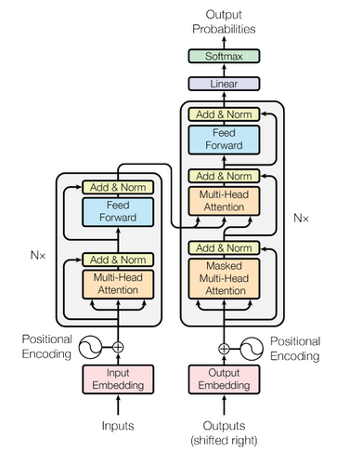
What is a Transformer?
The Transformer model is an attention based encoder-decoder type architecture.
As opposed to RNN’s, Transformers are non-sequential. Sentences are processed all at once instead of word by word.
Although Transformers were a major breakthrough in NLP, they still have trouble with long texts (BERT is limited to a maximum sequence length of 512).

Slide 4
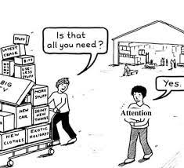
What is Attention?
The attention mechanism was introduced to improve the performance of the encoder-decoder model.
In a typical encoder-decoder model, the only information that the decoder receives from the encoder is the last encoder hidden state.
Attention is an interface between the encoder and decoder that provides the decoder with information from every encoder hidden state, resulting in a more flexible and robust model.

Slide 5

Self Attention
The attention mechanism is mainly used in encoder-decoder based RNN’s.
The Transformer, which is based on self-attention, doesn’t use RNN’s at all!
While the attention mechanism allows the decoder to access all of the inputs, self-attention enables the inputs to interact with each other.

Slide 6
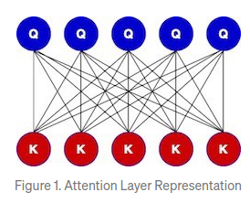
The Long-Document Transformer
Transformer-based models are unable to process long sequences due to their self-attention operation, which scales quadratically with the sequence length.
To address this limitation, the Longformer was introduced.
The Longformer has an attention mechanism that scales linearly with sequence length, making it easy to process documents of thousands of tokens or longer.

Slide 7
Main Steps
Preprocess the training data:
Store all of the essays in a convenient data structure.
Label each word with the corresponding label.
Split the training set into 4 folds.
Encode the raw text using the tokenizer.
Create class of the longformer model with dropout layers and a fully connected layer that has the specified output layer.
Train the model with 4-Fold cross validation.

Slide 8

Tokenization
Obviously, the model cannot understand raw text. The input to the model must be converted to meaningful numerical values.
Tokenization is the process of breaking down the text to smaller components (words, characters), and encoding them to a form that the model can understand.
Our model uses a pretrained tokenizer from the “Hugging Face” library.

Slide 9
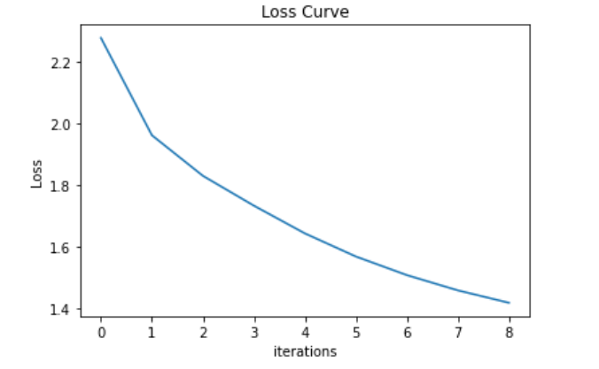
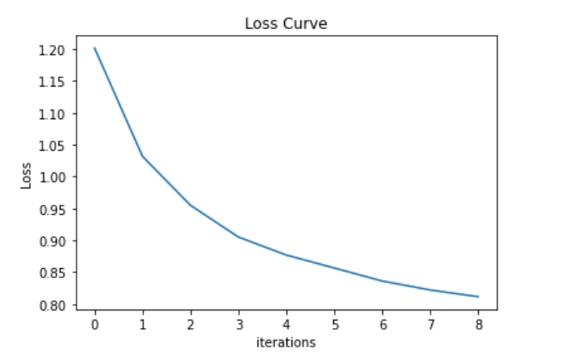
Hyper-Parameters
Too small learning rate => 4e-7
Good learning rate => 4e-5

Slide 10

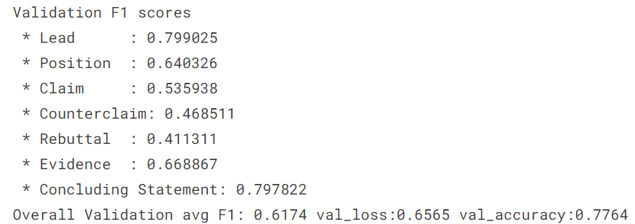
Results of one fold
As we can see, our model is not over-fitted since the training accuracy and the validation accuracy are very close.

Slide 11
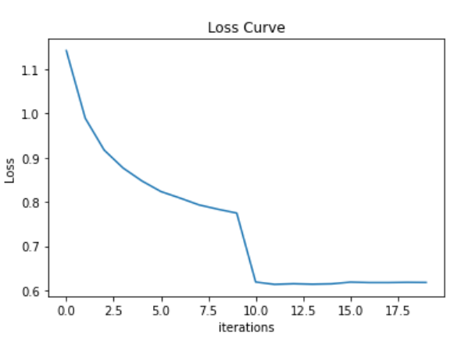
Learning Curves of One Fold
1 epoch
2 epochs
x300
x300

Slide 12
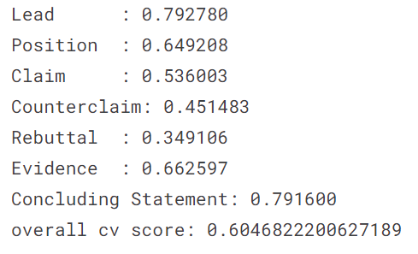
Cross Validation Score

Slide 13
Leaderboard Score

